Slide 1
SPAC size and dilution evolution
Antoine Clapaud & Louis Noirault
December, 12th 2023

Slide 2
1. EDGAR database
p. 3
p. 2
p. 3
Page 2

Slide 3
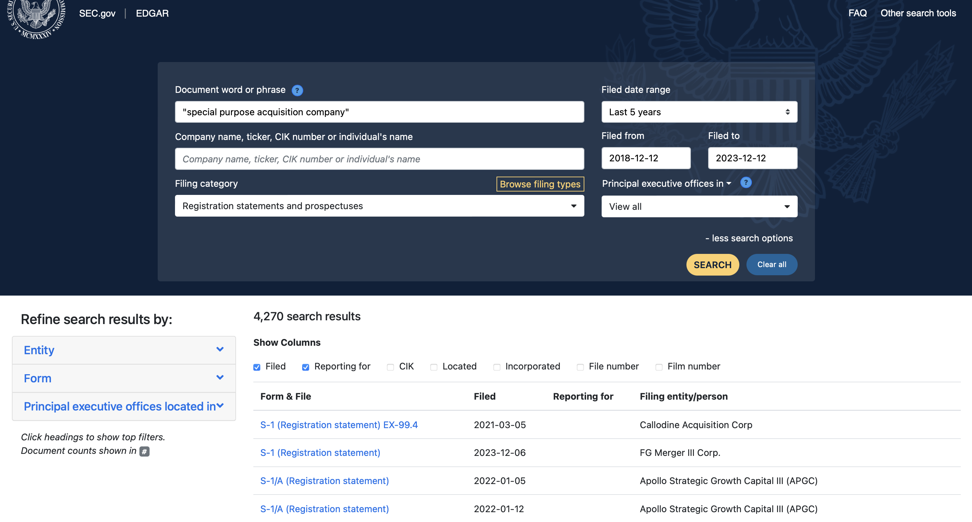
Presentation of the EDGAR database (1/2)
A dynamic website with different iframes

Slide 4
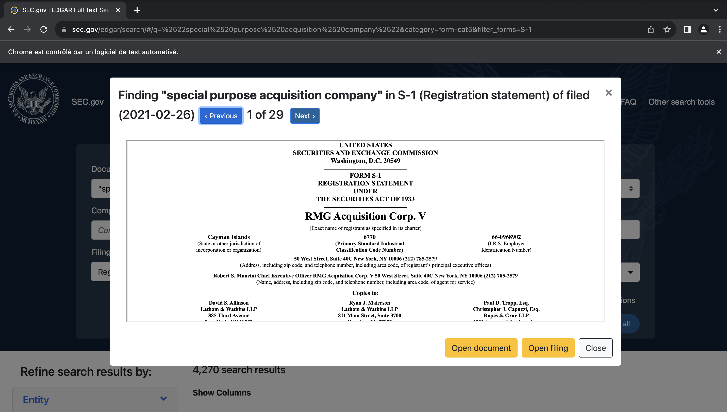
Presentation of the EDGAR database (2/2)
A dynamic website with different iframes

Slide 5
2. Scraping EDGAR
p. 3
p. 2
p. 3
Page 5

Slide 6
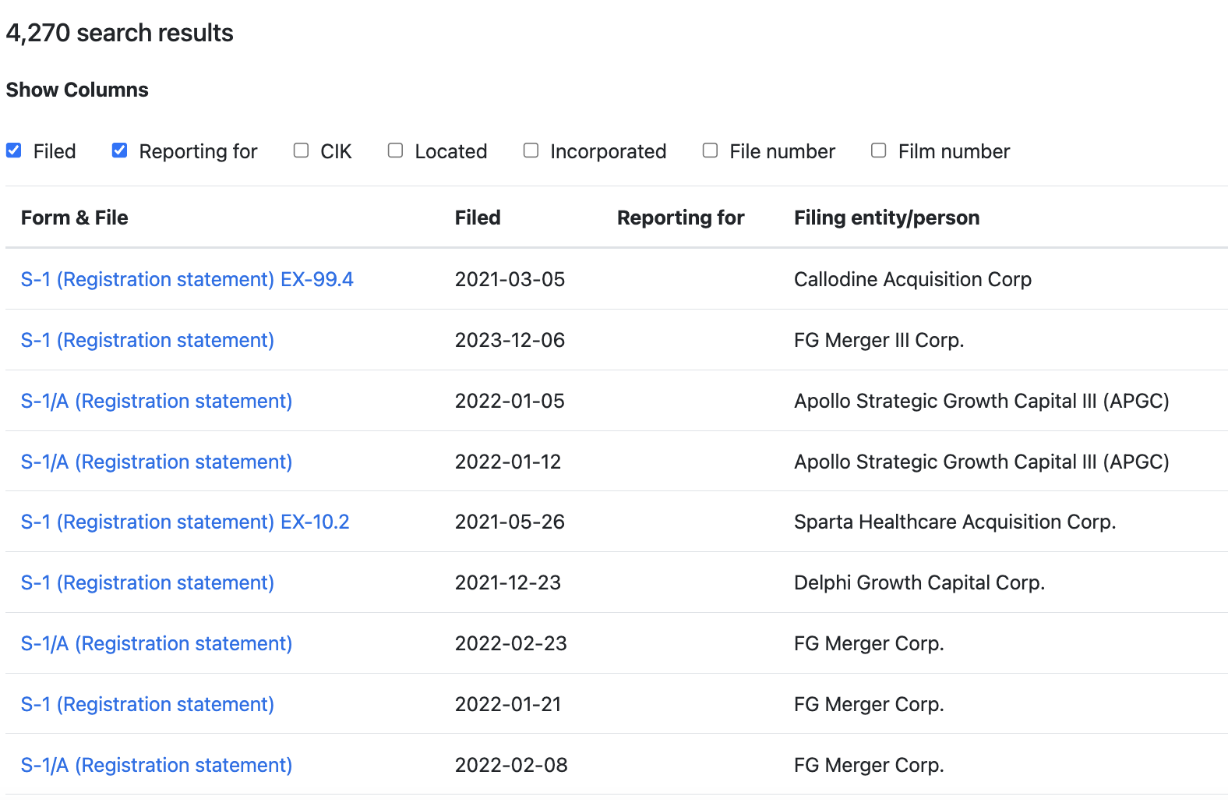
Scraping EDGAR
First challenge: clicking on the right links
The code has to click only on the S-1 document type

Slide 7
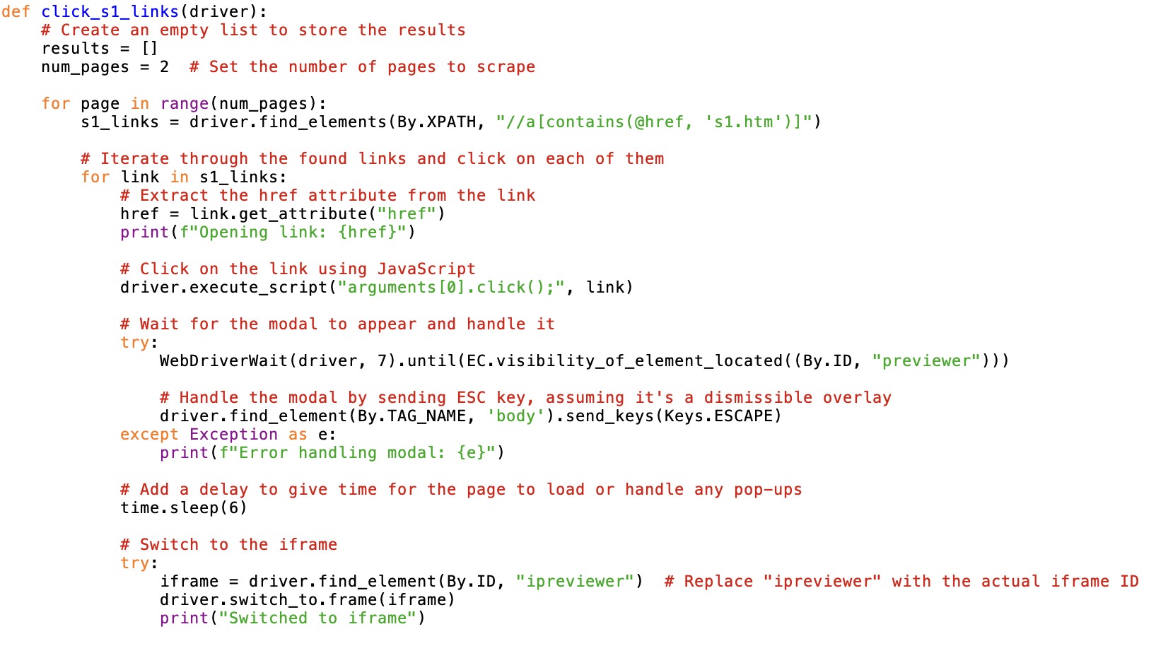
Scraping EDGAR
First challenge: clicking on the right links
After inspection of the webpage source code

Slide 8
Scraping EDGAR
Second challenge: switching the focus to the pop-up window

Slide 9
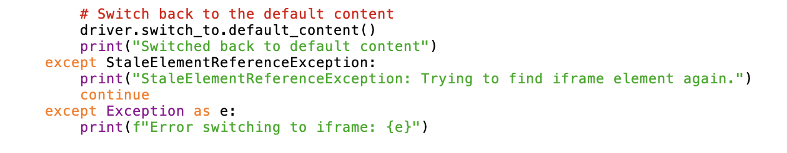
Scraping EDGAR
Second challenge: switching the focus to the pop-up window
Function to switch the focus from the search result to the pop-up iframe

Slide 10
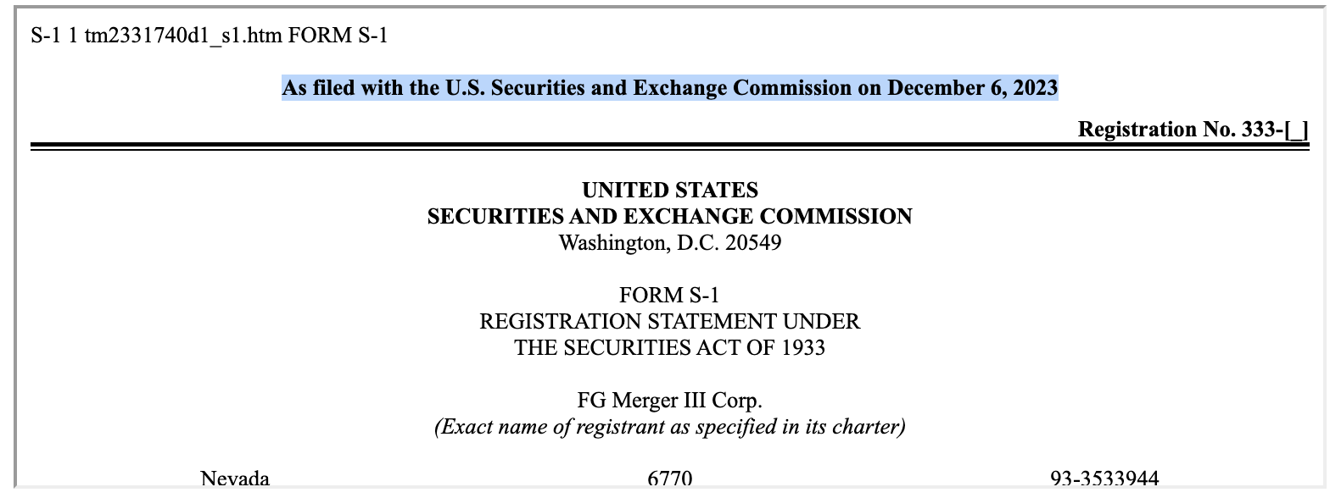
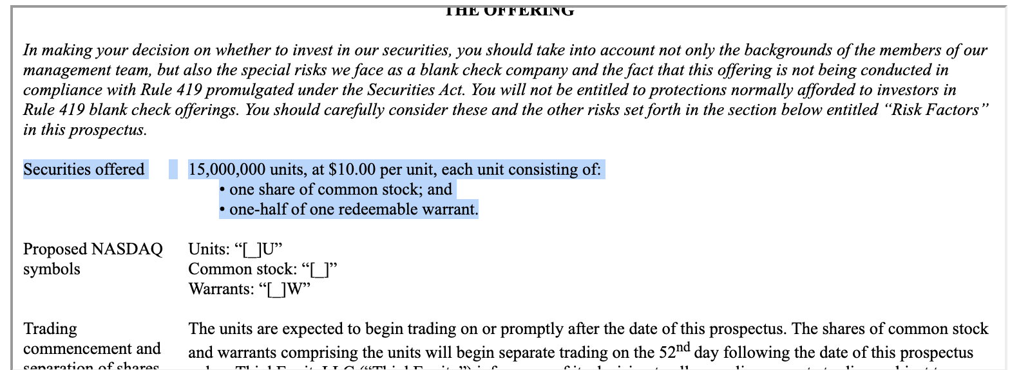
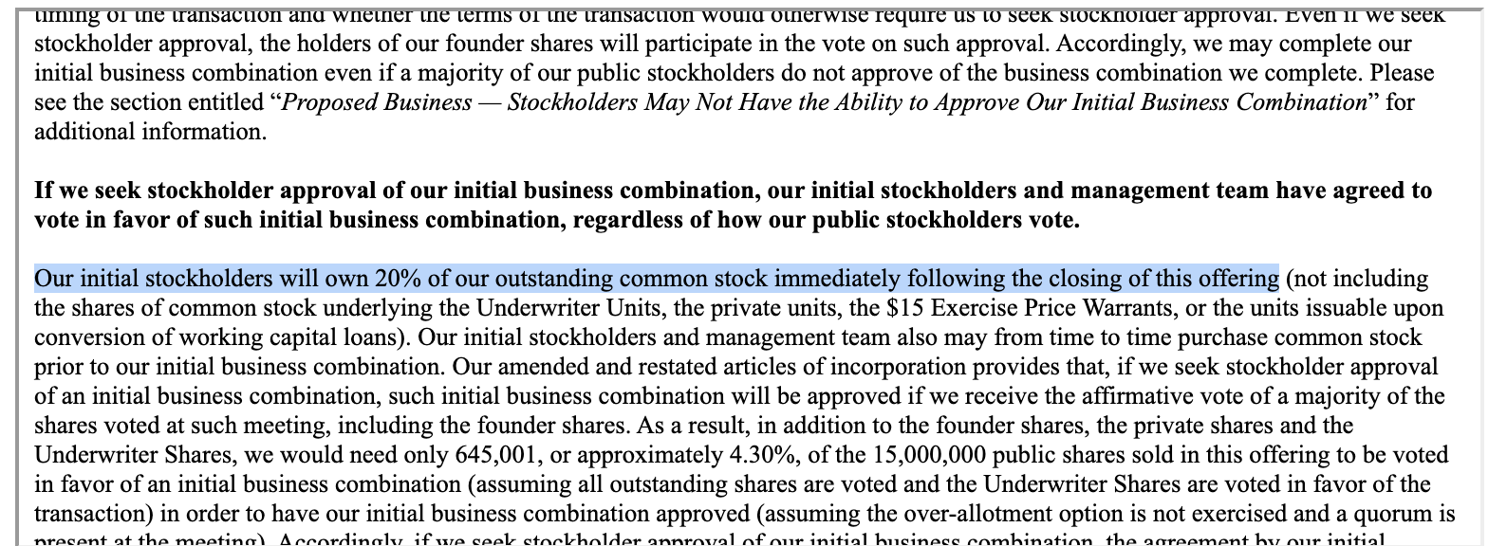
Scraping EDGAR
Third challenge: identify date, units number and price, and percentage dilution

Slide 11
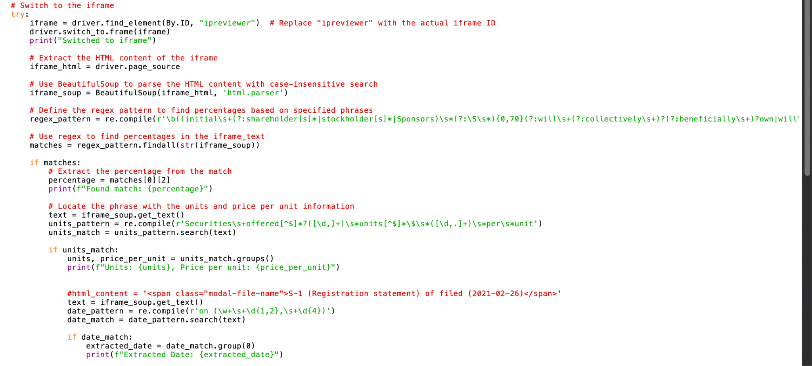
Scraping EDGAR
Third challenge: identify date, units number and price, and percentage dilution
First regex function to identify the founder share percentage following a sentence pattern
Second regex function to identify the number and price of securities offer
Third regex function to identify the date of the filing

Slide 12
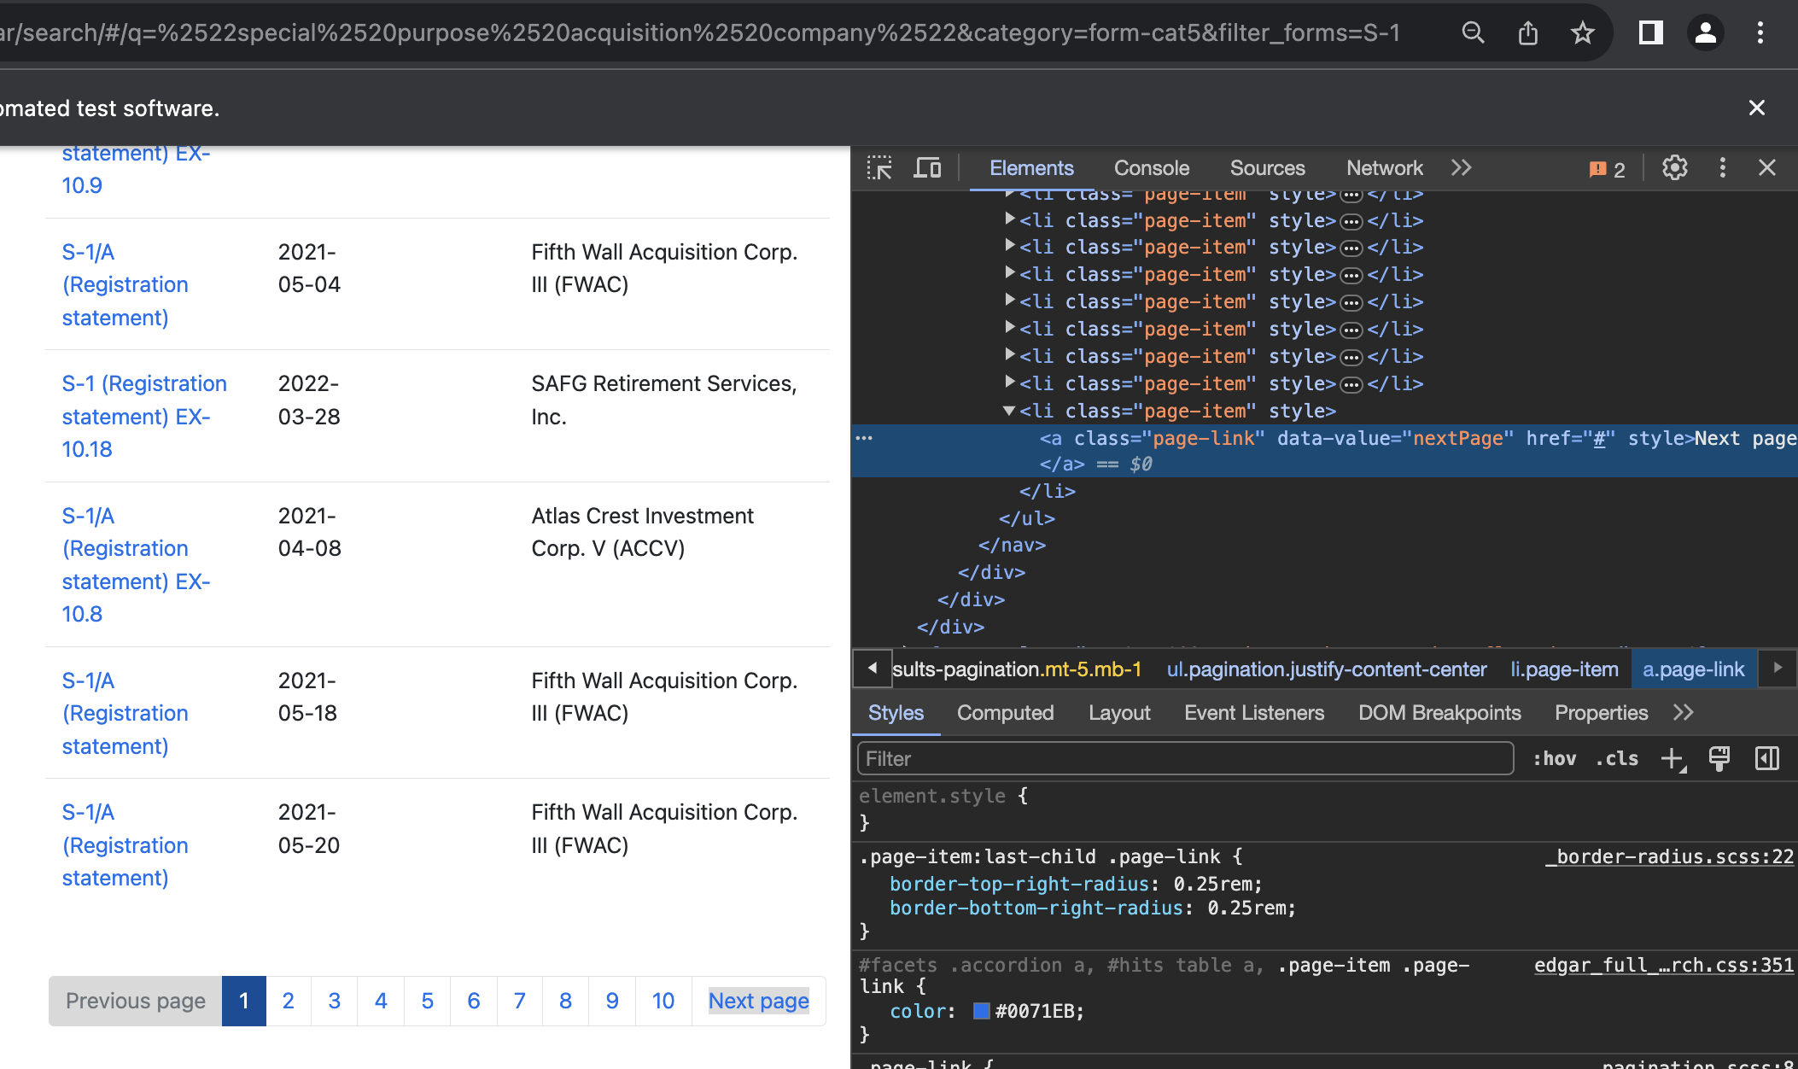
Scraping EDGAR
Last challenge: switch to the next page
Identify the pattern to switch to the next page

Slide 13
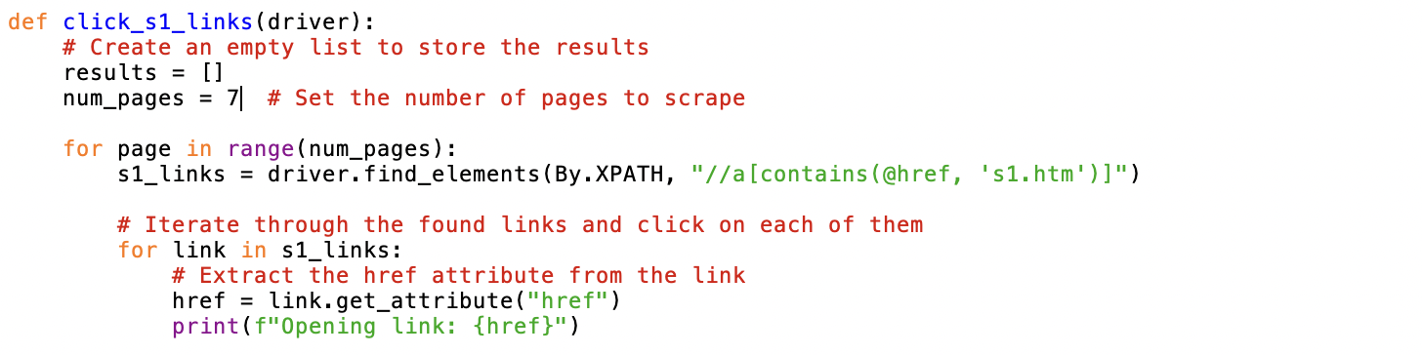
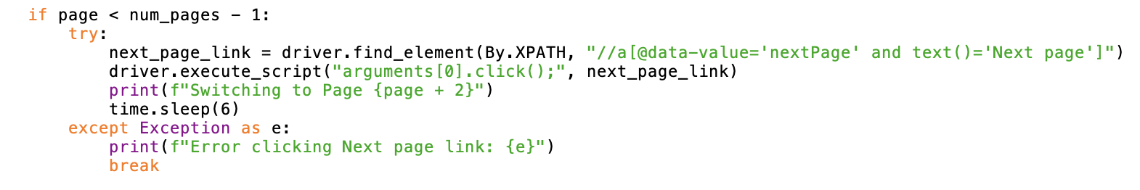
Scraping EDGAR
Last challenge: switch to the next page
Next page button patterm

Slide 14
3. Dataframe Construction
p. 3
p. 2
p. 3
Page 14

Slide 15
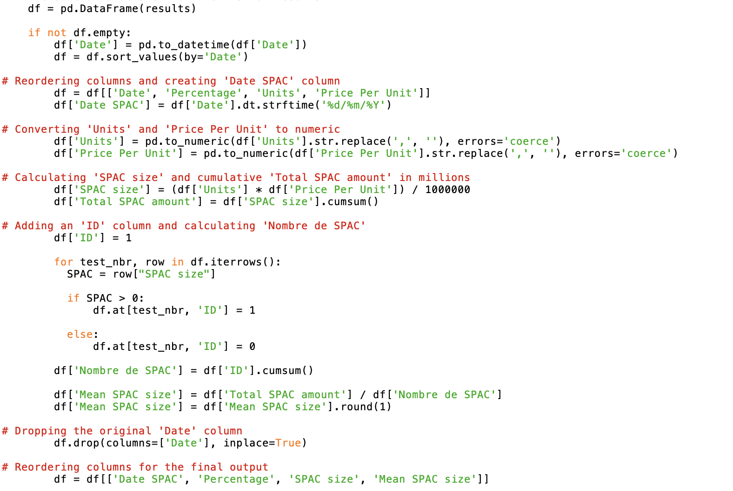
Dataframe constructiom
Creation of a panda dataframe to collect all the information

Slide 16
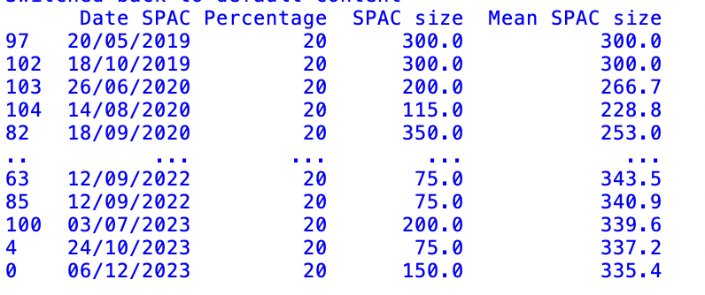
Dataframe constructiom
Creation of a panda dataframe to collect all the information

Slide 17
4. Scraping results
p. 3
p. 2
p. 3
Page 17

Slide 18
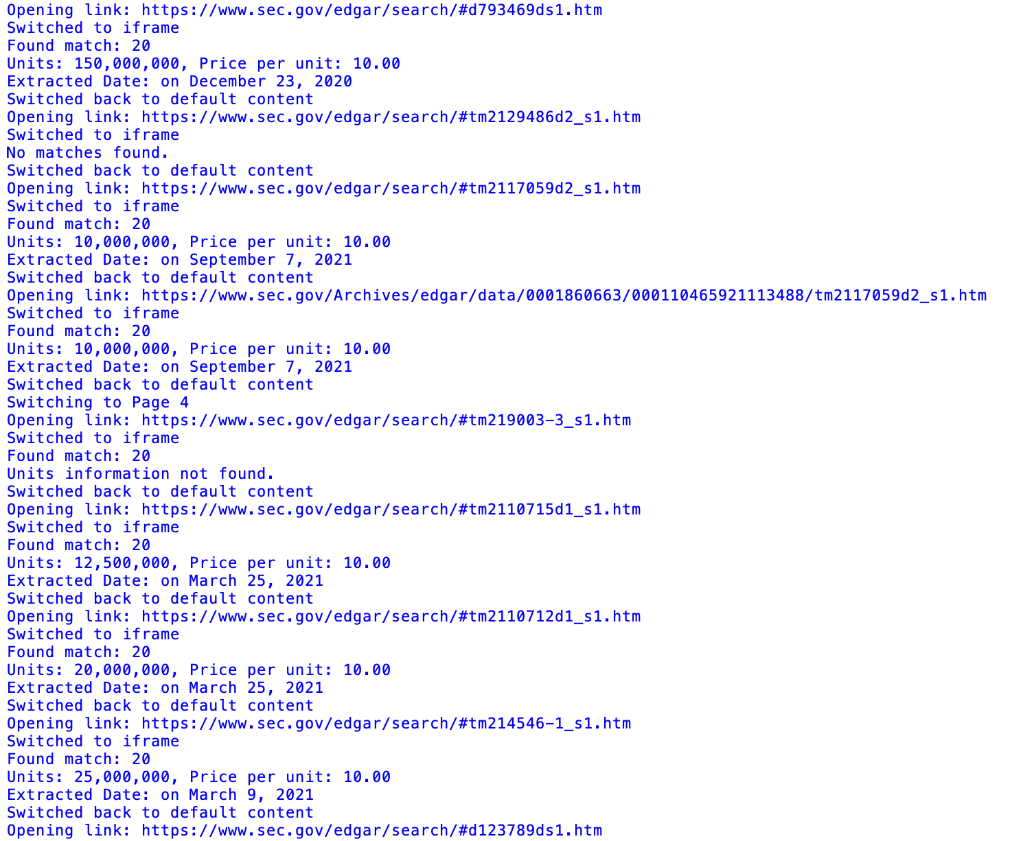
Scraping results
We have run the code over the results pages of the SEC’s website
The code is properly collecting the data asked for each SPAC under a S-1 document
On every pages available

Slide 19
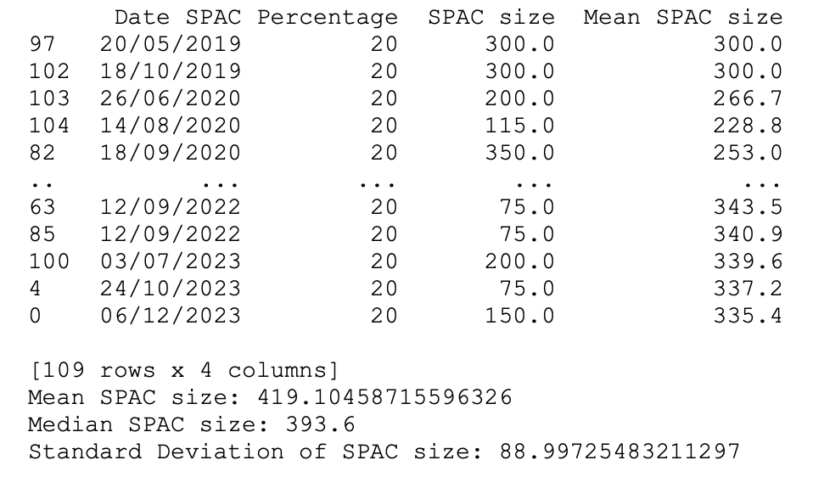
Scraping results
EDGAR database does not grant access to all the documents available for the period

Slide 20
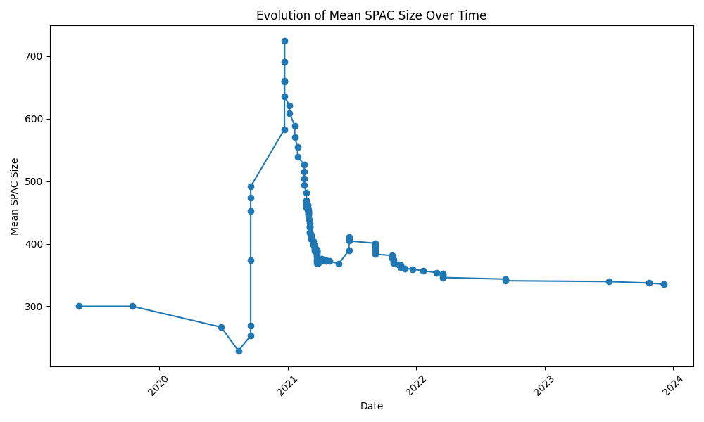
Scraping results
EDGAR database does not grant access to all the documents available for the period

Slide 21
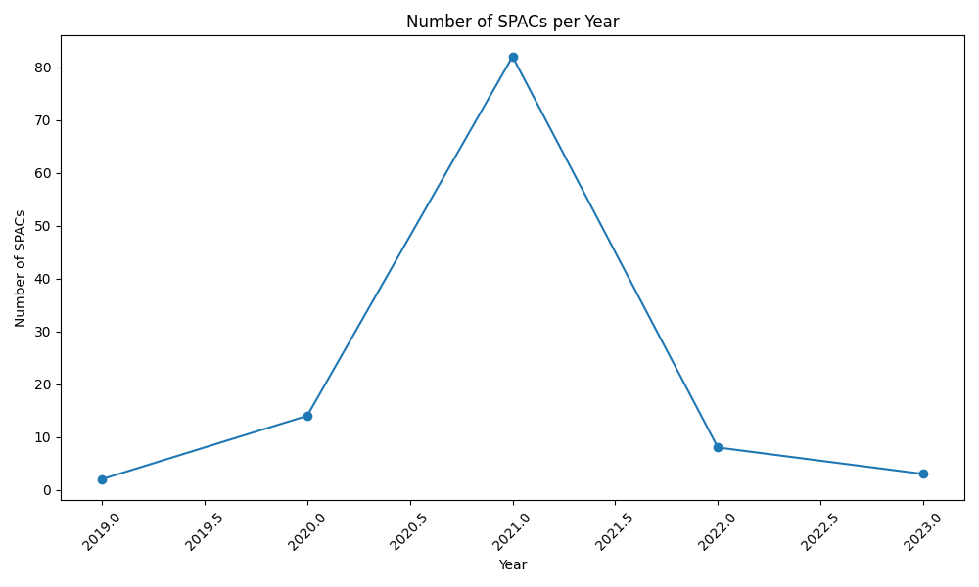
Scraping results
EDGAR database does not grant access to all the documents available for the period

